Slide 1
Bayesian Inference for Mixture Language Models
Chase Geigle, ChengXiang Zhai
Department of Computer Science
University of Illinois, Urbana-Champaign

Slide 2
Extensions of PLSA
PLSA with prior knowledge ➔ User-controlled PLSA
PLSA as a generative model ➔ Latent Dirichlet Allocation

Slide 3
PLSA with Prior Knowledge
Users may have expectation about which topics to analyze
We expect to see “retrieval models” as a topic in IR.
We want to see aspects such as “battery” and “memory” for opinions about a laptop
Users may have knowledge about what topics are (or are NOT) covered in a document
Tags = topics ➔ A doc can only be generated using topics corresponding to the tags assigned to the document
We can incorporate such knowledge as priors of PLSA model

Slide 4
Maximum a Posteriori (MAP) Estimate
We may use p(Λ) to encode all kinds of preferences and constraints, e.g.,
p(Λ)>0 if and only if one topic is precisely “background”: p(w|θ_{B})
p(Λ)>0 if and only if for a particular doc d, π_{d,3}=0 and π_{d,1}=1/2
p(Λ) favors a Λ with topics that assign high probabilities to some particular words
The MAP estimate (with conjugate prior) can be computed using a similar EM algorithm to the ML estimate with smoothing to reflect prior preferences

Slide 5
EM Algorithm with Conjugate Prior on p(w| θ_{i})
Prior: p(w|θ’_{j})
battery 0.5 life 0.5
Pseudo counts of w
from prior θ’
+μp(w|θ’_{j})
+μ
What if μ=0? What if μ=+∞?
Sum of all pseudo counts
We may also set any parameter to a constant (including 0) as needed

Slide 6
Deficiency of PLSA
Not a generative model
Can’t compute probability of a new document (why do we care about this?)
Heuristic workaround is possible, though
Many parameters ➔ high complexity of models
Many local maxima
Prone to overfitting
Overfitting is not necessarily a problem for text mining (only interested in fitting the “training” documents)

Slide 7
Latent Dirichlet Allocation (LDA)
Make PLSA a generative model by imposing a Dirichlet prior on the model parameters ➔
LDA = Bayesian version of PLSA
Parameters are regularized
Can achieve the same goal as PLSA for text mining purposes
Topic coverage and topic word distributions can be inferred using Bayesian inference

Slide 8
PLSA ➔ LDA
Both word distributions and
topic choices are free in PLSA
p(w|θ₁)
government 0.3 response 0.2 ...
Topic θ₁
p(θ₁)=π_{d,1}
p(w|θ₂)
city 0.2 new 0.1 orleans 0.05 ...
w
Topic θ₂
…
…
p(θ₂)=π_{d,2}
donate 0.1 relief 0.05 help 0.02 ...
p(w|θ_{k})
Topic θ_{k}
p(θ_{k})=π_{d,k}
LDA imposes a prior on both

Slide 9
Likelihood Functions for PLSA vs. LDA
PLSA
Core assumption
in all topic models
LDA
PLSA component
Added by LDA

Slide 10
Parameter Estimation and Inferences in LDA
Parameters can be estimated using ML estimator
However, {θ_{j}} and {π_{d,j}} must now be computed using posterior inference
Computationally intractable
Must resort to approximate inference
Many different inference methods are available
How many parameters in LDA vs. PLSA?

Slide 11
Posterior Inferences in LDA
Computationally intractable,
must resort to approximate inference!

Slide 12
Illustration of Bayesian Estimation
Bayesian inference: f(θ)=?
Posterior:
p(θ|X)∝ p(X|θ)p(θ)
Likelihood:
p(X|θ)
X=(x₁,…,x_{N})
Posterior
Mean
Prior: p(θ)
θ
θ₀: prior mode
θ₁: posterior mode
θ_{ml}: ML estimate

Slide 13
LDA as a graph model [Blei et al. 03a]
α
distribution over topics
for each document
(same as π_{d} on the previous slides)
Dirichlet priors
θ ^{(d)}
β
θ ^{(d)} ∼ Dirichlet(α)
distribution over words
for each topic
(same as θ _{j} on the previous slides)
topic assignment
for each word
φ ^{(j)}
z_{i}
z_{i} ∼ Discrete(θ ^{(d)} )
φ ^{(j)} ∼ Dirichlet(β)
T
word generated from
assigned topic
w_{i}
w_{i} ∼ Discrete(φ ^{(zi)} )
N_{d}
D
Most approximate inference algorithms aim to infer
from which other interesting variables can be easily computed

Slide 14
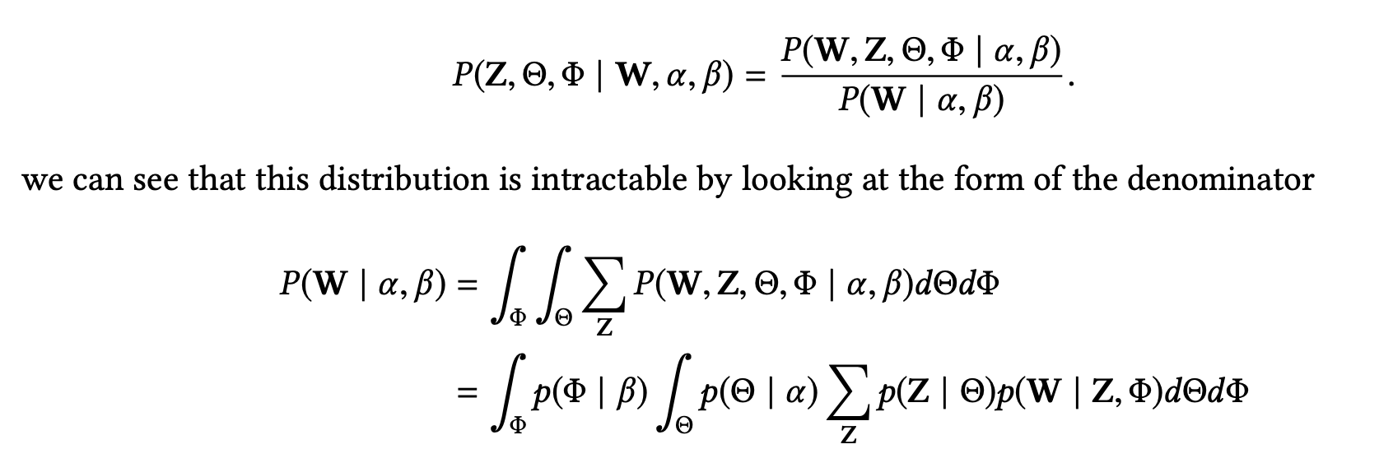
Posterior Inferences in LDA
Computationally intractable,
must resort to approximate inference!

Slide 15
Approximate Inferences for LDA
Many different ways; each has its pros & cons
Deterministic approximation
variational EM [Blei et al. 03a]
expectation propagation [Minka & Lafferty 02]
Markov chain Monte Carlo
full Gibbs sampler [Pritchard et al. 00]
collapsed Gibbs sampler [Griffiths & Steyvers 04]
Most efficient, and quite popular, but can only work with conjugate prior

Slide 16
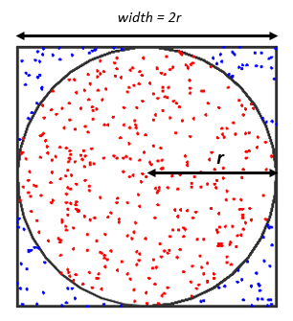

Monte Carlo

Slide 17
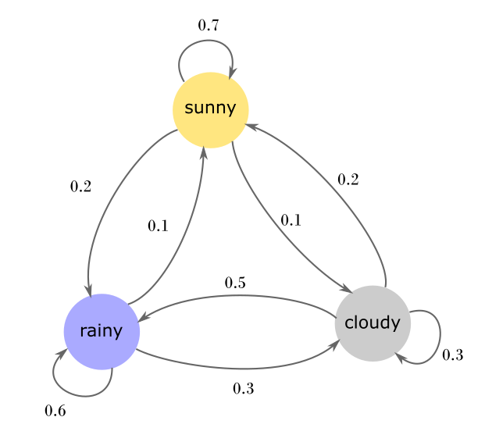
Markov Chain

Slide 18
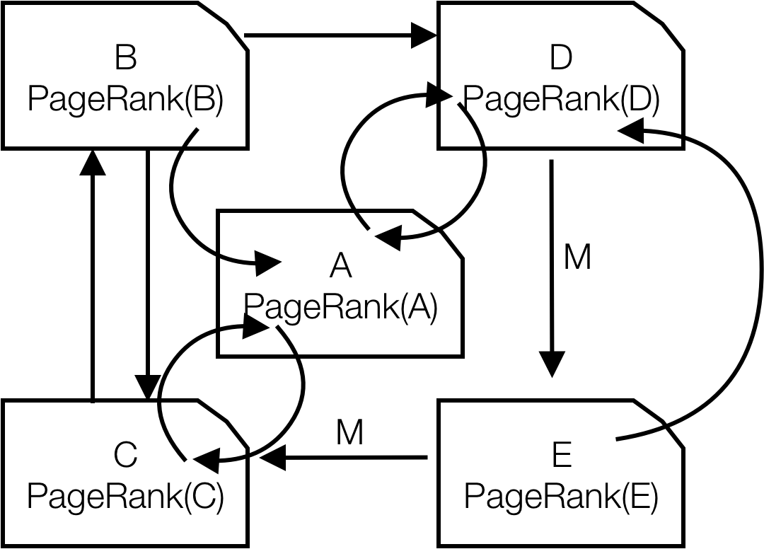
Markov Chain Monte Carlo

Slide 19
The collapsed Gibbs sampler [Griffiths & Steyvers 04]
Using conjugacy of Dirichlet and multinomial distributions, integrate out continuous parameters
Defines a distribution on discrete ensembles z

Slide 20
The collapsed Gibbs sampler [Griffiths & Steyvers 04]
Sample each z_{i} conditioned on z_{-i}
This is nicer than your average Gibbs sampler:
memory: counts can be cached in two sparse matrices
optimization: no special functions, simple arithmetic
the distributions on Φ and Θ are analytic given z and w, and can later be found for each sample

Slide 21
Gibbs sampling in LDA
iteration
1

Slide 22
Gibbs sampling in LDA
iteration
1 2

Slide 23
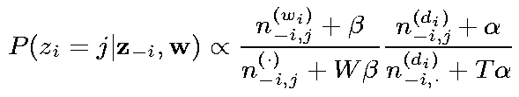
Gibbs sampling in LDA
iteration
1 2
words in d_{i} assigned with topic j
Count of instances where w_{i} is
assigned with topic j
Count of all words
assigned with topic j
words in d_{i} assigned with any topic

Slide 24
Gibbs sampling in LDA
iteration
1 2
What’s the most likely topic for w_{i} in d_{i}?
How likely would d_{i} choose topic j?
How likely would topic j
generate word w_{i} ?

Slide 25
Gibbs sampling in LDA
iteration
1 2

Slide 26
Gibbs sampling in LDA
iteration
1 2

Slide 27
Gibbs sampling in LDA
iteration
1 2

Slide 28
Gibbs sampling in LDA
iteration
1 2

Slide 29
Gibbs sampling in LDA
iteration
1 2 … 1000

